Slide 1


Consulting Report
Telecom – Maharashtra

Slide 2
Description
Context Setting & Problem Statement
Data Set Summary
Data Mining
Data Cleaning & Analysis
EDA
Proposed Solution
Tools Used
Conclusion
Table of Contents

Slide 3



Context Setting
Leading Telecom Service Provider
Focus on Client Satisfaction and Future Requirement
Service
Online Presence – Website, Mobile apps, Social Media presence
Digital Footprint
Target Gender & location
Identify Gap in Service
Marketing and Advertising
Problems

Slide 4
Problem Statement Provided
It's always wonderful to see services customized to your needs. Businesses try to understand your behavior and adjust their offerings so as to ensure you feel attached to their services.
Do an Analysis of the preprocessed data.
Here are the points about how Analysis should be done:
Distribution of Users(device_id) across States.
Distribution of Users across Phone Brands(Consider only 10 Most used Phone Brands).
Distribution of Users across Gender.
Distribution of Users across Age Segments.
Distribution of Phone Brands(Consider only 10 Most used Phone Brands) for each Age Segment, State, Gender.
Distribution of Gender for each State, Age Segment and Phone Brand(Consider only 10 Most used Phone Brands).
Distribution of Age Segments for each State, Gender and Phone Brand(Consider only 10 Most used Phone Brands).
Note: While doing analysis for the above points, consider only one instance of a particular User(device_id) as a User can do multiple phone calls and considering every instance of the same User can give misleading numbers.
Hourly distribution of Phone Calls.
Plot the Users on the Map using any suitable package.

Slide 5
Data Set Summary
Device Owner Table
74645 Records
Device Brand Table
87726 Records
Events Table
3252950 Records
Column | Null Count
device_id | 0
gender | 0
age | 0
group | 0
Column | Null Count
device_id | 0
phone_brand | 0
device_model | 0
Column | Null Count
event_id | 0
device_id | 453
timestamp | 0
longitude | 423
latitude | 423
city | 0
state | 377
Loaded Events data from : events_data.csv
Loaded Owner & Device Brand data using MySQL Connector based on given credentials.

Slide 6
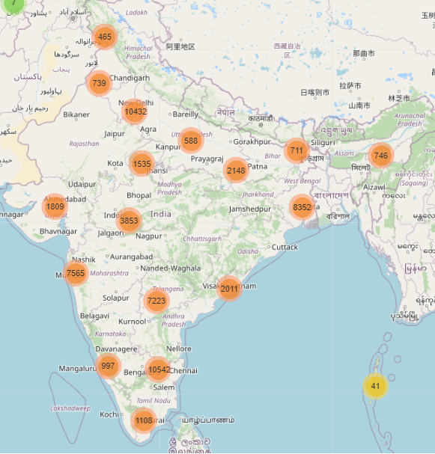
Data Set Summary MAP

Slide 7
Data Mining
Our consulting team focused on the priority markets of Maharashtra to study the user’s behavior based on :
Mobile usage
Geolocation
Demographic profiling
Mobile device
As per the study need and observations on the above-mentioned parameters.
we have cleaned and purified the data to extract useful insights and knowledge to identify the business opportunities in the focused markets.
Observations:
Event Data imputation/correction required for device_id, latitude, longitude & state, no missing values in Owner and Brand Data
Timestamp is of object datatype
In phone brand translation of non-English data to English is required

Slide 8
Data Analysis
Importing & Loading
Imported required numpy, pandas, mysql.connector, matplotlib,seaborn library
Loaded Events Data from csv file, Owner and Brand data from mysql
Loading
Profiling
Pre-Processing
Profiling post Pre-Processing
Performed Pandas Profiling before preprocessing. Output generated in Event_Pre_Processing.html
Preliminary analysis using pandas commands like .info(), ,shape, describe(), head(), columns, unique(), nunique() and Pandas profiling
Observed missing values, duplicate & erroronous data
Profiling
Pre-Processing
Removed Duplicate data
Performed Data correction for missing & erroronous data for price, mileage, engV, engType, Drive data
Profiling post Pre-Processing
Performed Pandas Profiling before preprocessing. Output generated in Event_Post_Processing.html

Slide 9
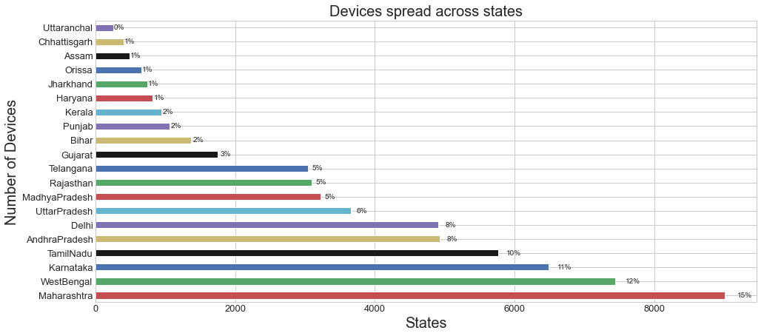
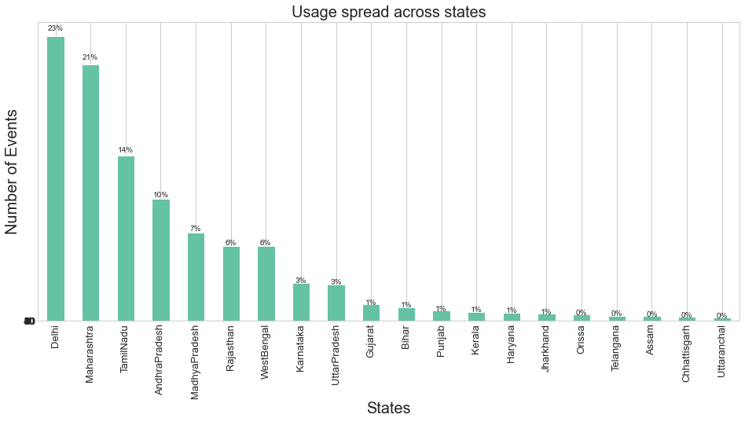
State wise Overview
EDA
1
Analysis

Slide 10
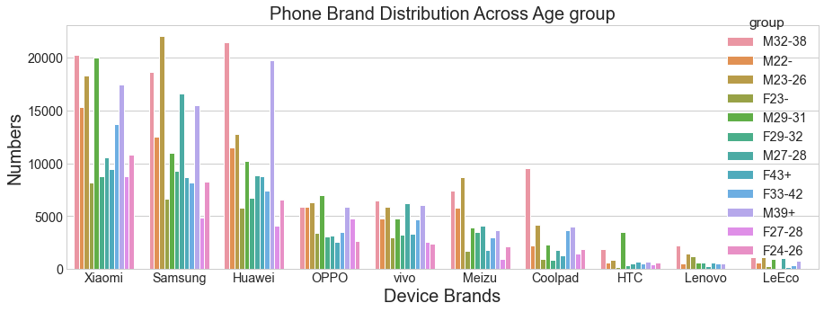
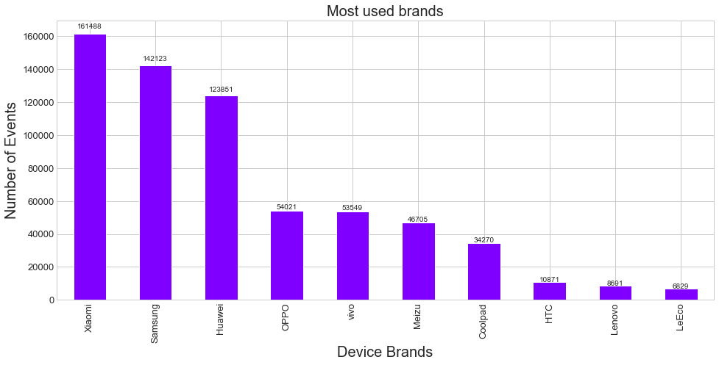
Brand wise Analysis
Top 10 brands (2010 -2016)
EDA
2
Analysis

Slide 11
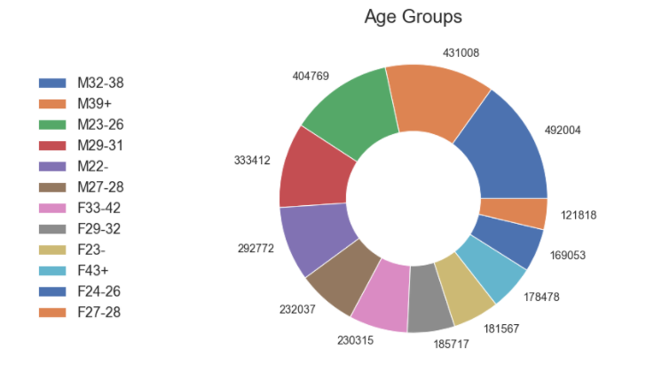
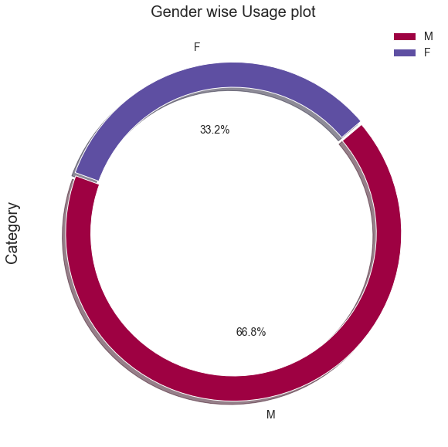
Gender wise & Age Group based analysis
EDA
3
Male 2186002 & Female 1066948

Slide 12
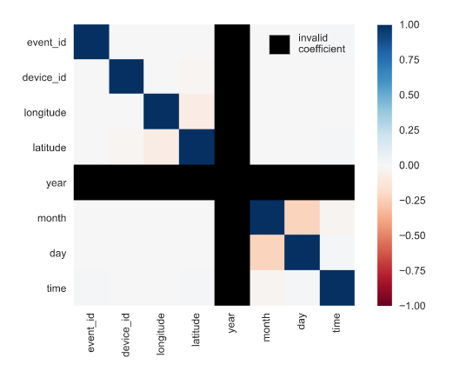
Co-relation of with other parameters
EDA
Positive correlation between
4

Slide 13







Tools Used

Slide 14
Conclusion & Actionable Insights
Insaid Telecom must divide the target market into smaller market segments and introduce specialized plans for each segment such as M32-38, F23-, in order to target customers more efficiently
Tie ups with brands such as LeEco, Lenovo, HTC are highly recommended to attract customers who buy a new phone
Geolocation analysis highlights the need to address the tier 2 cities aggressively. This can be done by introducing competitive promotional strategies like family plans to increase the number of users.
Retention strategies should be deployed in tier 1 cities due to the competitive nature of the industry, as the market has already been penetrated sufficiently

Slide 15
Thank you
Telecom – Maharashtra

